Slide 1

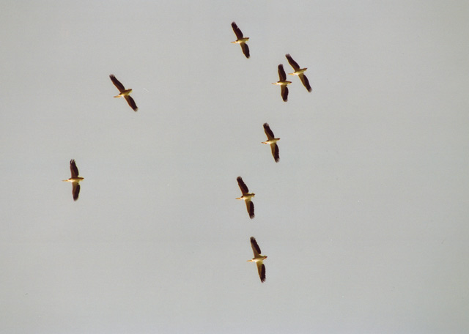
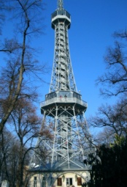
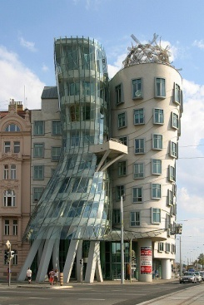
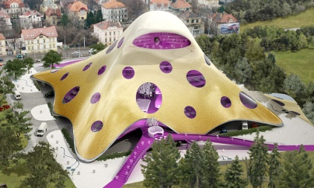
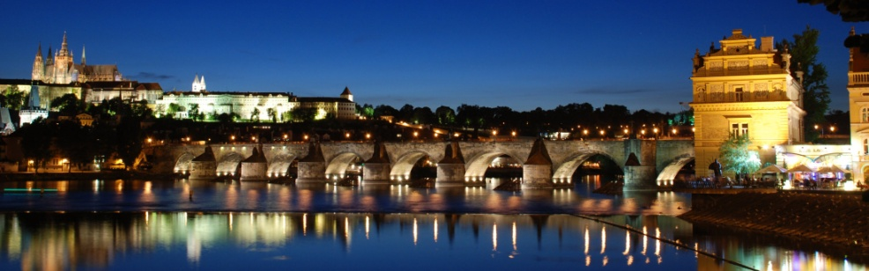
This work was supported by grants of the Czech Science Foundation P407-12-1541 Information Technology Competencies of Children and their Development in Primary and Lower Secondary Schools.
Miroslava Černochová
Tomáš Komrska
Czech Republic
LITERACY FROM SCRATCH

Slide 2
Introduction
    ICT in Czech curriculum
Participants
    Primary School Korunovační
    Faculty of Education, Charles University in Prague
Starting points
    Creativity
    Art-Language-ICT
What pupils have done
What we have learnt for the future

Slide 3
Introduction: ICT in Czech curriculum
ICT as a compulsory subject in Primary Education and Lower Secondary Education
    Introduction into work with computer (User skills)
      use the basic, standard functions of a computer and its most common peripheries
      observe safety rules when working with hardware and software, and proceed in an informed manner in the case of their being faulty
      protect data from damage, loss or abuse
    Information searching and communication
      utilise simple and suitable ways when searching for information on the internet
      search for information on web portals, in libraries and in databases
      communicate by means of the internet and other common communication devices
    Information processing and application
      work with text and pictures in text and graphics editors
NO Computer Science, Informatics
NO programming
ONLY: Orientation on ICT
ONLY: To apply algorithmical thinking
It is necessary to do changes!
To implement elements of CS
FEP EE (2007) Framework Education Programme for Elementary Education (with amendments as of 1st September 2007). Prague, 2007

Slide 4
Participants
Primary School
ZŠ Korunovační
    Headmaster
    Primary Education Teachers
    Pupils (about 45)
      Year 3 (aged 8-9)
      Year 5 (aged 10-11)
      Year 4-6 (aged 9-12)
      Year 7 (aged 13-14)
Faculty of Education, Charles University in Prague
    ICT student teacher
    ICT teacher trainer (supervisor)

Slide 5
Starting points: Creativity
    School educational programme: Creative school
  a key idea for teaching in all subjects in all levels and and approach to pupils thinking and learning
“A mutual acceptance of teachers and parents is a fundamental presumption in order that a pupil would not struggle against his/her learning and school, and s/he would have positive reactions to education. It means schoolteachers perceive parents as the best ones for their children. And on the other hand, parents accept school and its teachers as the best school, and the best teachers for their child. It is very important that parents and teachers should create and arrange for a child to have an emotionally safety space for his/her development and school work.”
The school applies a fundamental principle for designing learning activities which reflects J.A.Comenius’s idea that “pupils who are plugged into learning actively and through all senses, adopt and acquire new knowledge and skills more easily than in the case of traditional teaching, based on the transmission and interpretation of study matter as ready knowledge, or on doing notes in workbooks, and memorization.”
www.tvorivaskola.cz
http://www.korunka.gns.cz/cl1801736408.htm

Slide 6
Starting points: Art-Language-ICT
ART
LANGUAGE
ICT (CS)

Slide 7
The idea
AIM
To design their own original animated stories (to share with children from UK)
MOTIVATION
Children and their pets walking in Prague
Sightseeing tour in Prague
Own original stories (fantasy)

Slide 8
The model
ART
To design a story in four scenes + dialogue between characters (on paper)
To draw „costumes“ for sprites (on paper, in Scratch)
LANGUAGE
Essay
ICT(CS)
To develop skills using Scratch
To arrange dialogue between „characters“
To manage movement of „characters“
To move from one scene to another one

Slide 9
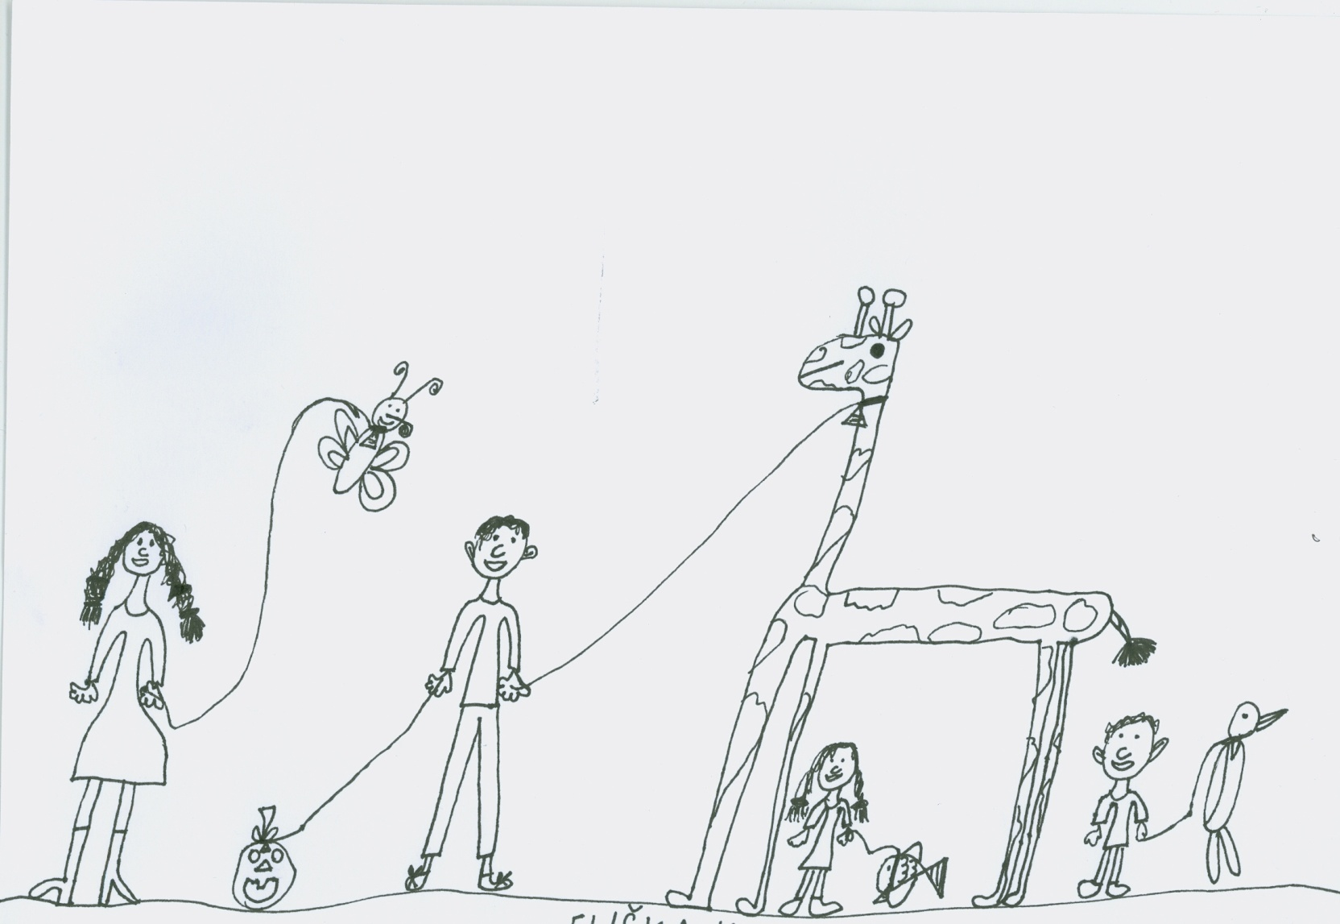
What pupils have done
ART
Children and their pets walking in Prague
Year 2 (Aged 7)

Slide 10
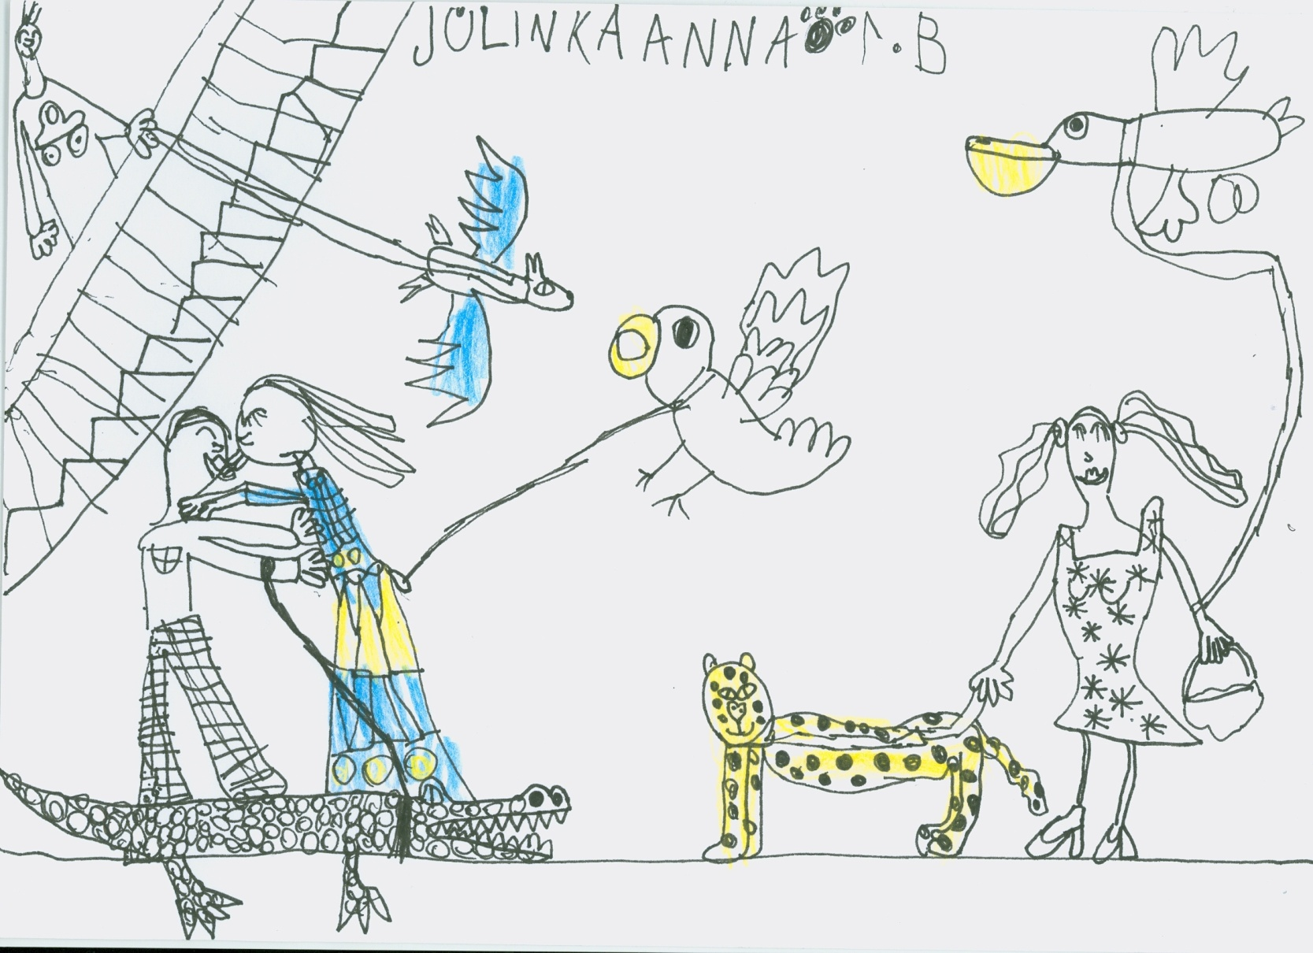
What pupils have done
ART
Children and their pets walking in Prague
Year 2 (Aged 7)

Slide 11
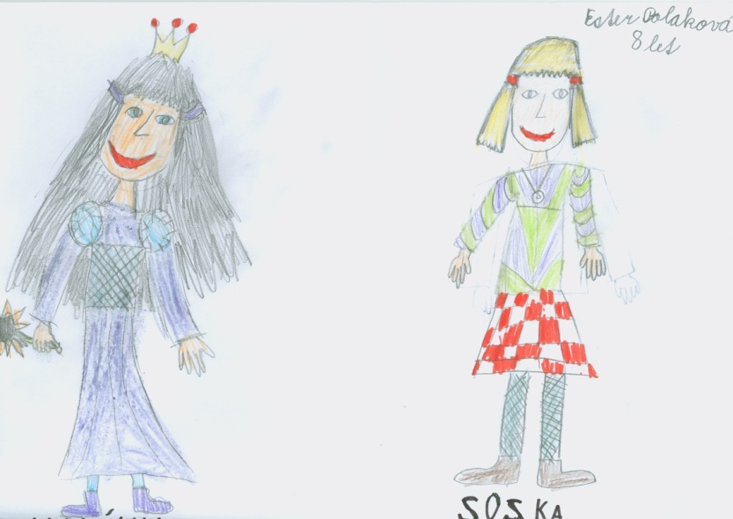
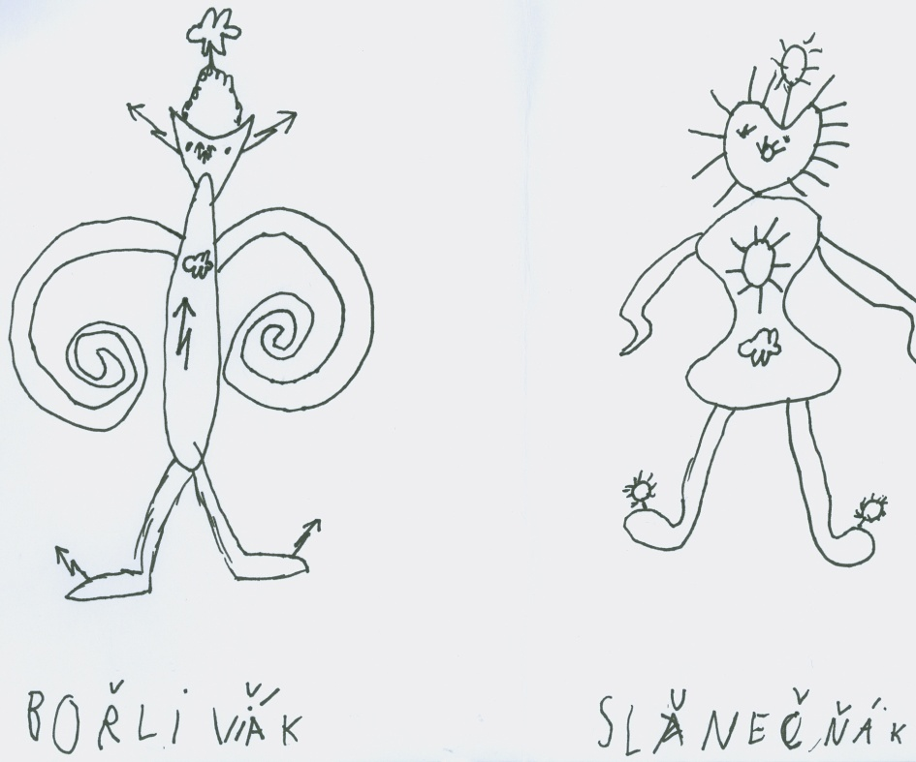
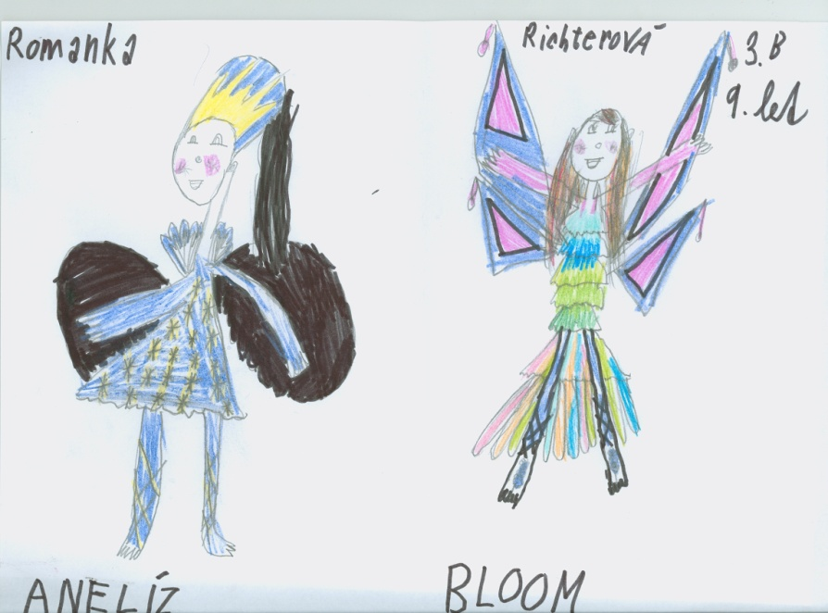
What pupils have done
ART
Sprites
Year 2 (Aged 7)
Year 3 (Aged 8)

Slide 12
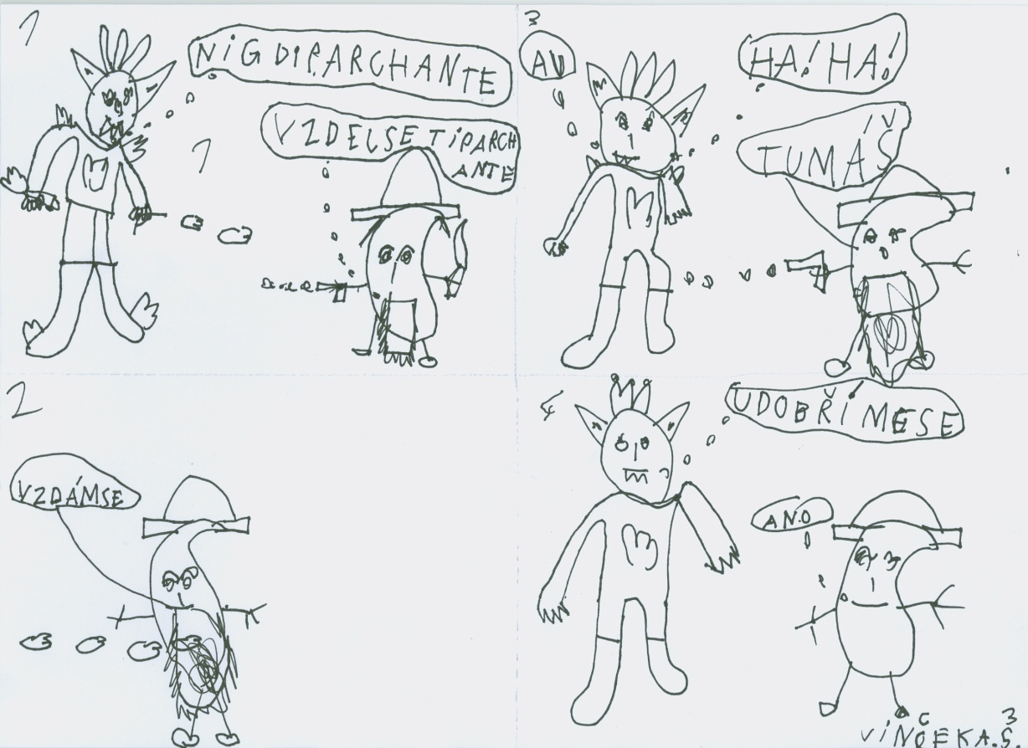
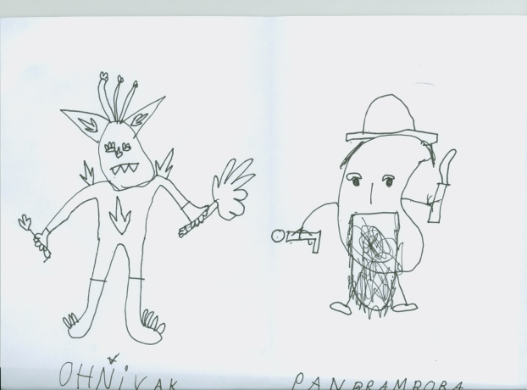
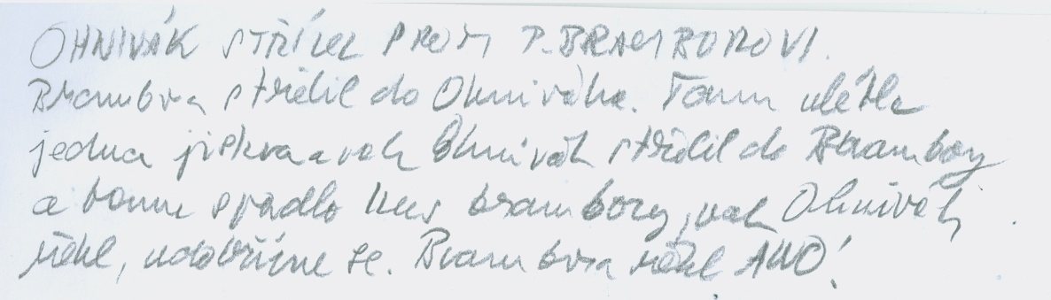
What pupils have done
ART
LANGUAGE
Own original story
Year 3 (Aged 8)

Slide 13
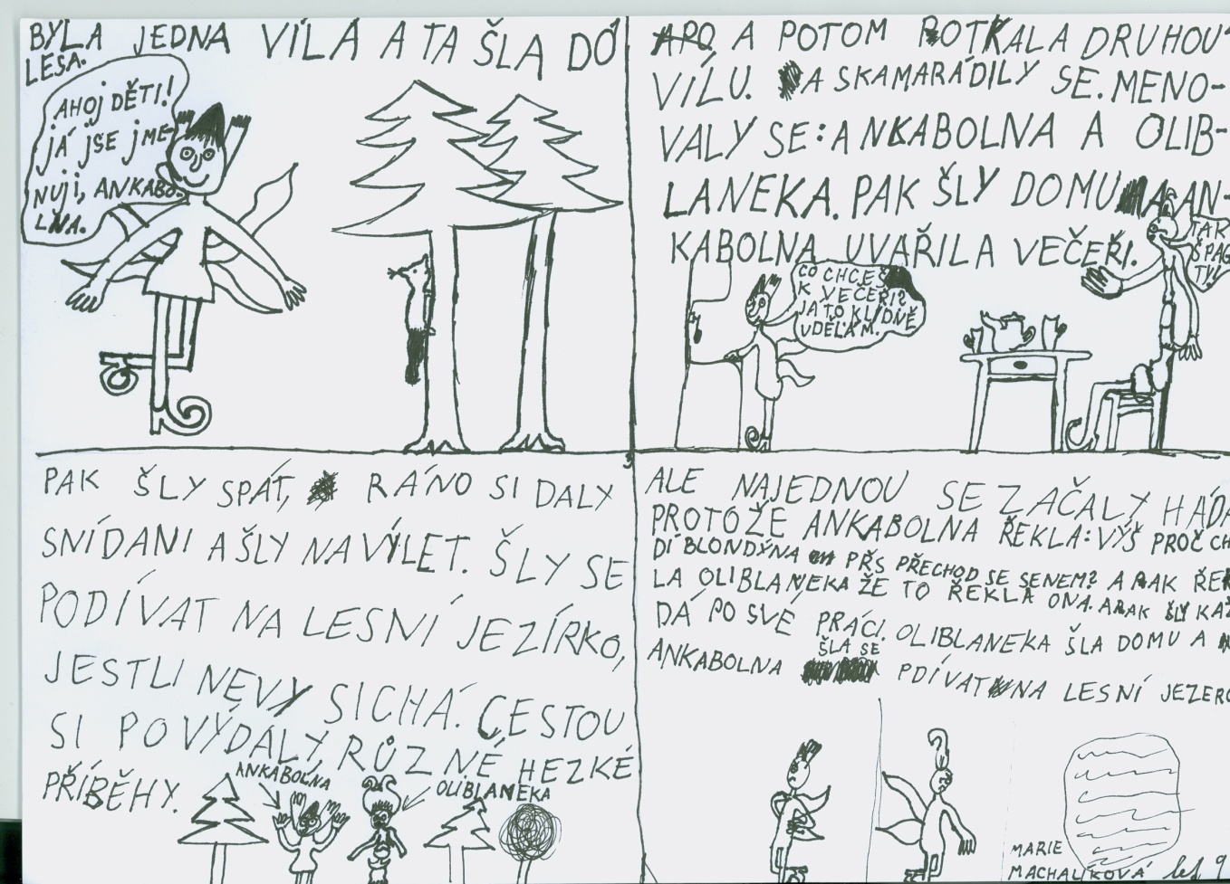
What pupils have done
ART
LANGUAGE
Own original story: frienship between two fairies
Year 3 (Aged 8)

Slide 14
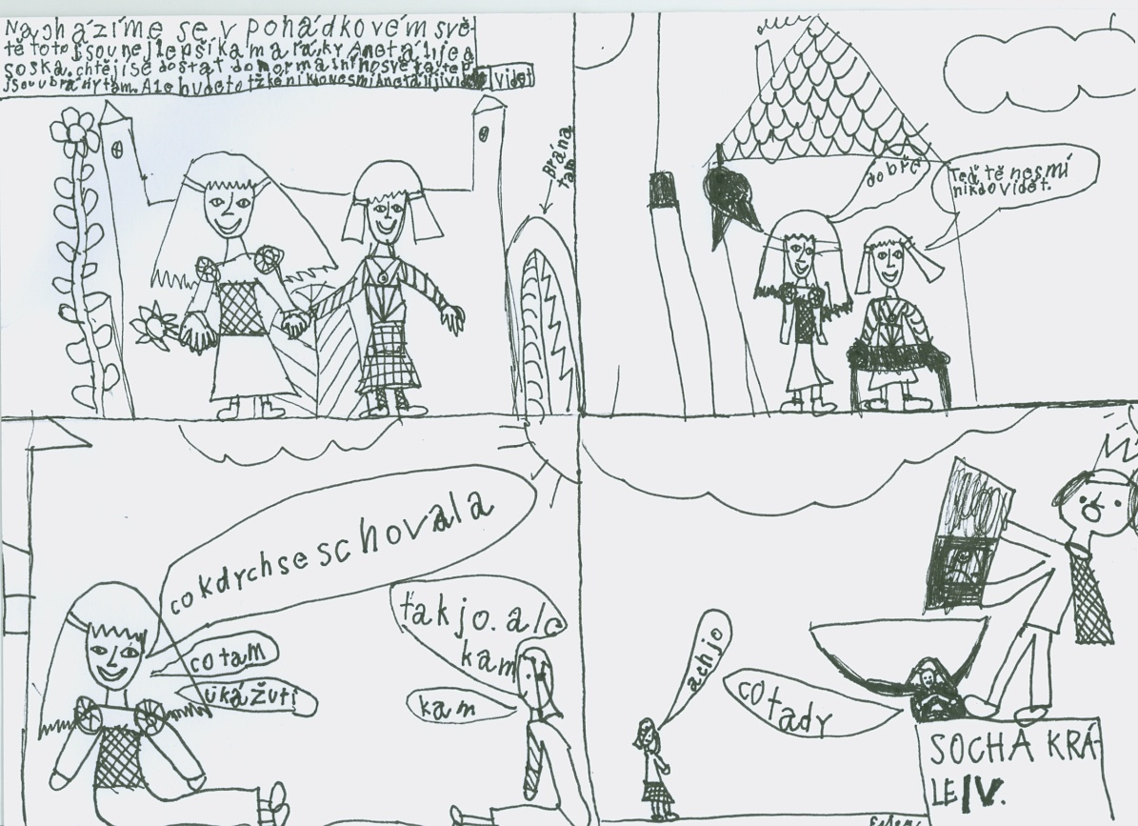
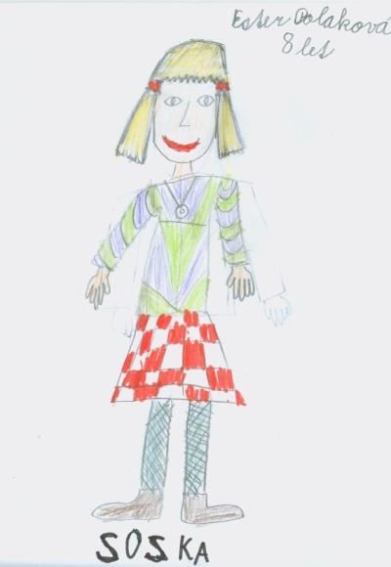
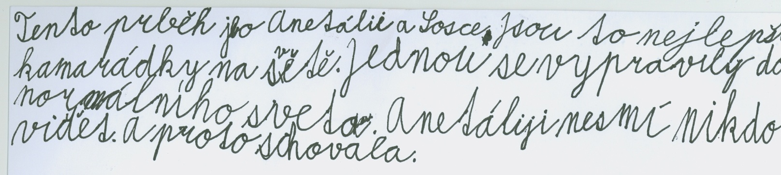
What pupils have done
ART
LANGUAGE
Own original
story
Year 3 (Aged 8)

Slide 15
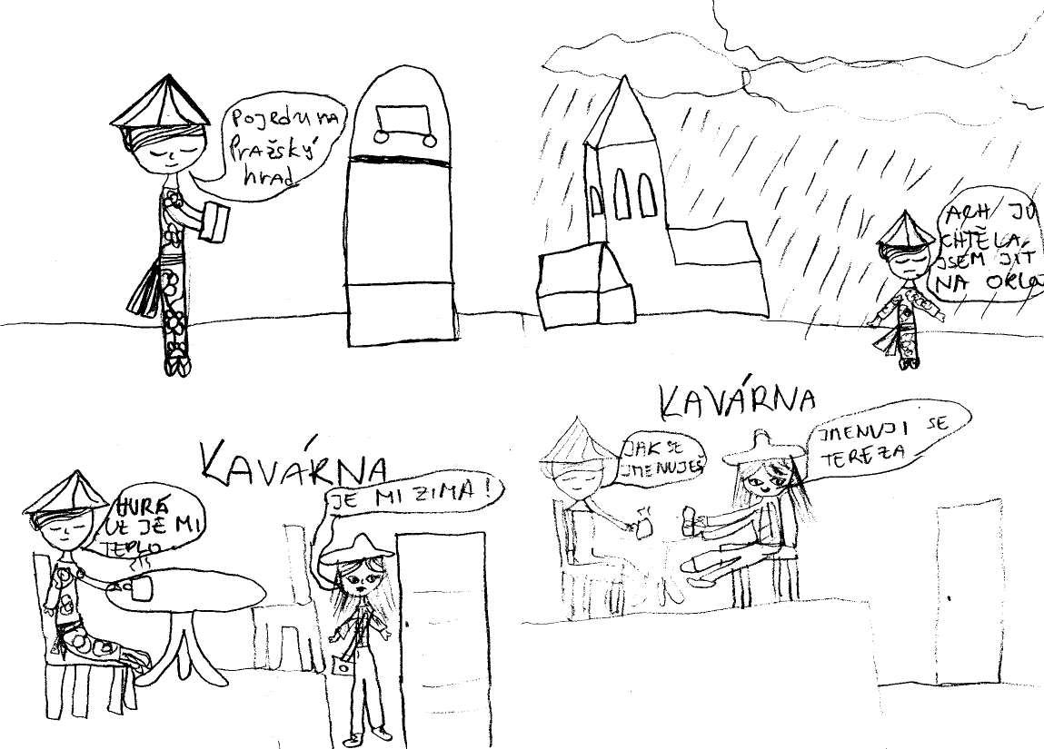
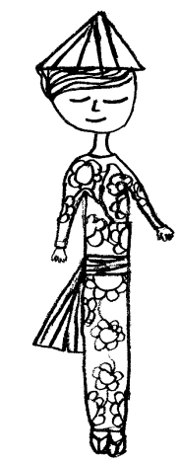
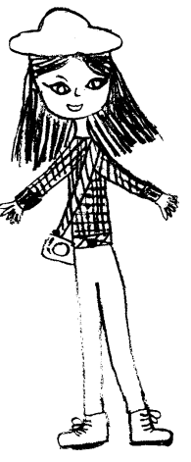
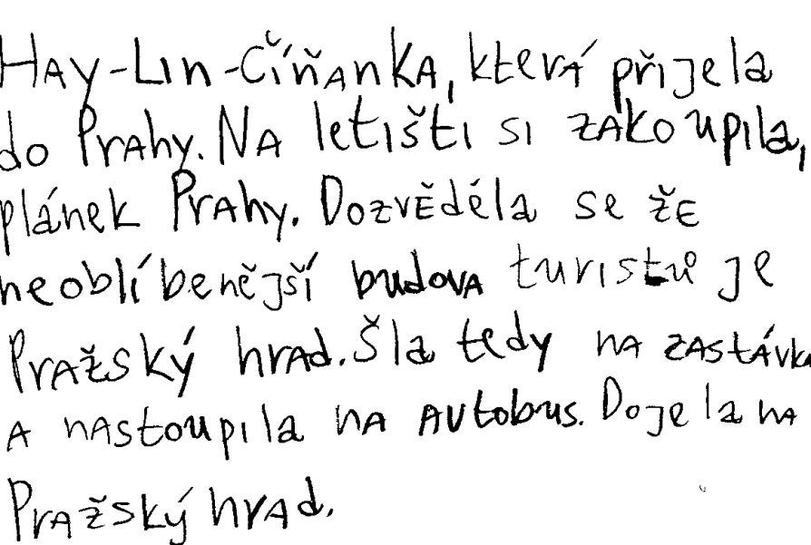
What pupils have done
ART
LANGUAGE
Sightseeing tour in Prague
Year 6 (Aged 11)

Slide 16
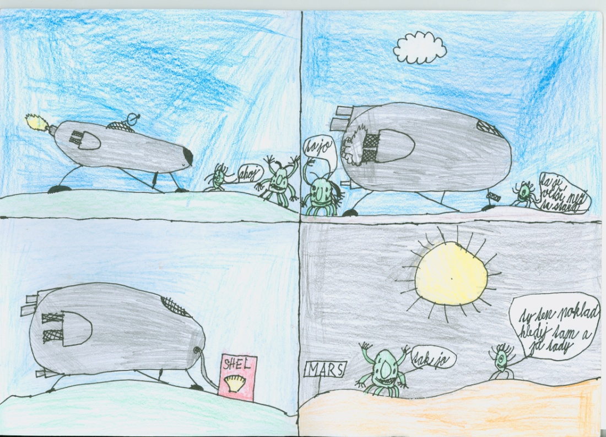
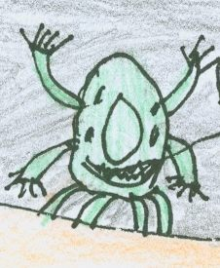
What pupils have done
ART
LANGUAGE
ICT
Own original story: Extra terrestrial
Year 5 (Aged 10)

Slide 17
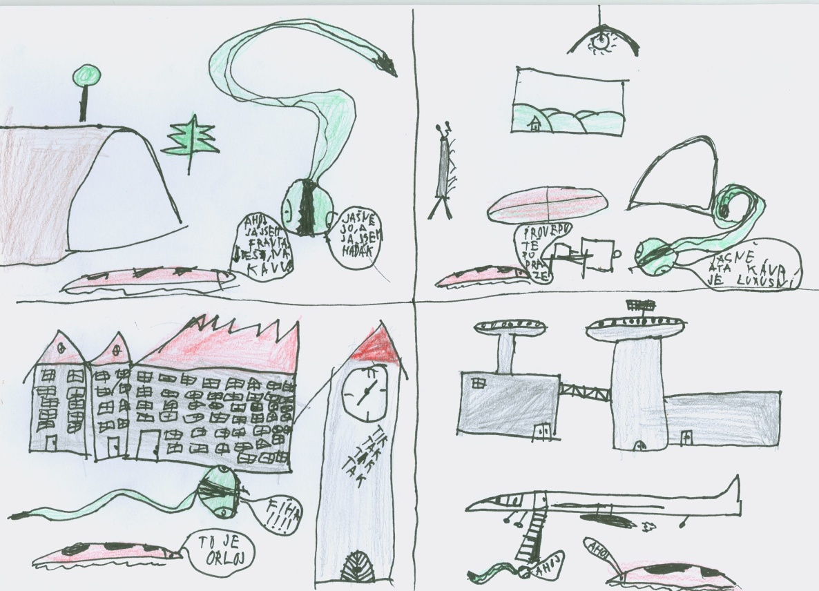
What pupils have done
ART
LANGUAGE
Own original story: Extra terrestrial
Year 5 (Aged 10)

Slide 18
What we have learnt
Some children
    concentrate more on graphics (“characters”), not on story.
    decided to use “characters” from Scratch to modify them for their stories, as it seems to be easier.
    have a problem to keep and follow their original “paper” story or scenario.

Slide 19
What we have learnt
M*****
    He has no motivation to design stories. He is fascinated by programming games.
    He very easily learnt the principle of sharing a collection of products by the Scratch community. He modified some examples published on the Web.
    He enjoys programming. He feels now as his father: his father is a programmer.
    He presents his results to his grandfather.
    His position in the school changed. He is not „outsider“ – he knows more than others, he can advise to his schoolmates.

Slide 20
Next steps
Methodology
  To follow a paper scenario (for example a joke)
  To understand Scratch
  To give more attention to telling story
To involve more ICT student teachers

Slide 21
Resources
FEP EE (2007) Framework Education Programme for Elementary Education (with amendments as of 1st September 2007). Research Institute of Education (VÚP) in Prague, 2007.
ZŠ Korunovační http://www.korunka.gns.cz/

